Slide 1

Surviving and Sustaining in a
Grant Seeking World
August 20, 2019
Dr. Debbie Douma, Dean
Office of Grants & Federal Programs

Slide 2
What is the grant seeking environment today?

Slide 3
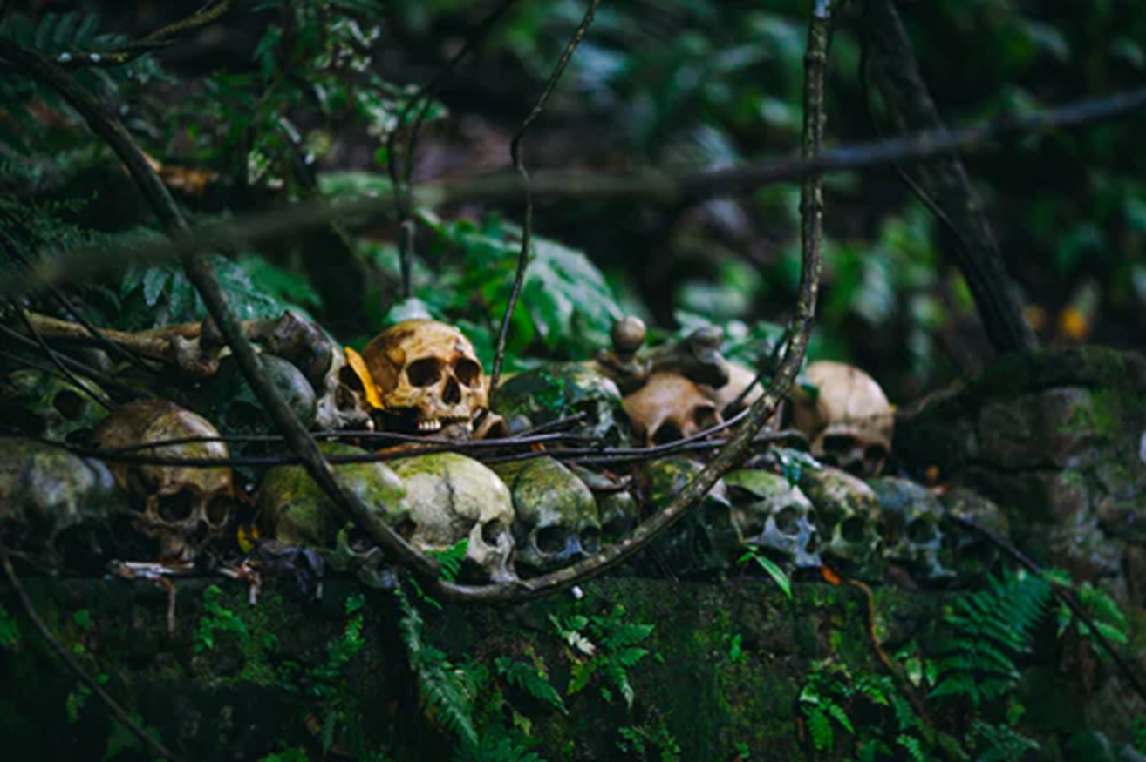

Slide 4
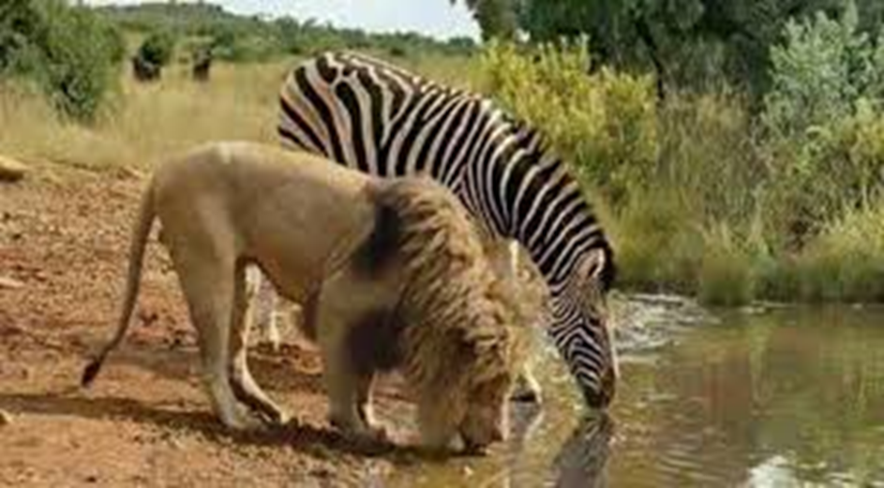
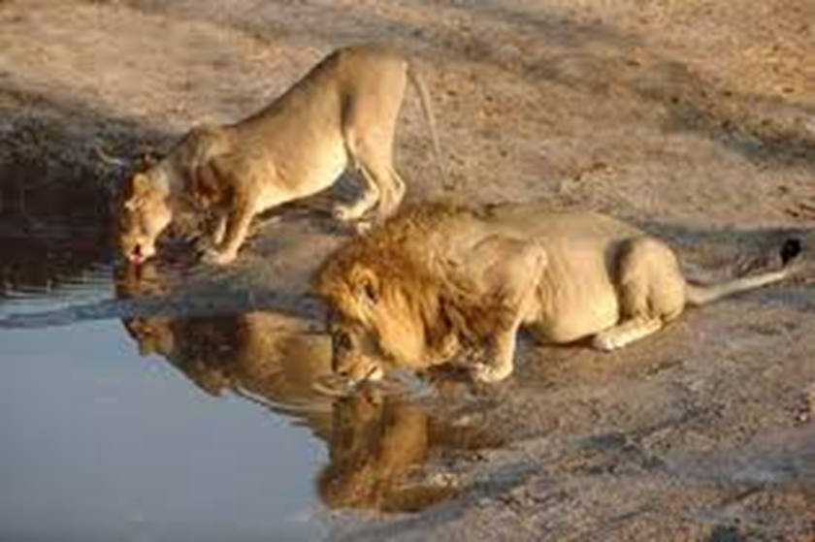

Slide 5
Basic Grant Considerations

Slide 6
7 Barriers to Grant Seeking
Strategic planning. Are you chasing the money?
Institutional capacity. It is no one’s job.
Funders. Are you submitting to the right opportunities?
Time. “I thought I had plenty of time to put this thing together and get it submitted!”
Substance. Have you done a literature review (Google Scholar)?
Length. There just isn’t enough room to tell our story.
Size. Too small? Too big?
Is there a relationship between the perceived barriers and
the number of grants obtained?
Notes:
Substance – You “know” your idea is good without any kind of research to back it up. You need a well-designed plan which is supported by data. Model best practices.
Length – a major complaint is that you never have enough room to tell your story. Grants are about saying less rather than more. Describe your idea in a succinct and precise manner – indicates that it has been well thought out. If you want to be a better grant writer take a journalism class.
Size – you bypass smaller grants going only after big, more competitive grants

Slide 7
“Trending” Funding Priorities
State and Federal
Local Initiatives
Anything that creates jobs
Apprenticeships
Economic development
Health Care
Education
  Completion/retention
Cybersecurity
Energy
Quality of life
Early learning
Housing and food security
The Arts
FAFSA completion
Workforce readiness
Notes:
Project grants – acquisition of equipment for a computer lab; funding for an art exhibit
Program grants – mentoring program, job-preparation
Operating grants –rent, utilities, staff costs – expect results (increase income, move to a larger facility, etc.)
Organizational Effectiveness grants – study practices, hire a consultant to develop a program; carry out recommendations of a consultant, implement internal strategies to improve outcomes
Capacity-building grants – implement annual campaign; purchase corporate/foundation directories; build a new exhibit to bring in more visitors/income
Capital – equipment, structures, buildings, and major equipment
Endowment – Principal funds aren’t spent, only the interest is spent each year for general operating expenses or earmarked purposes

Slide 8
Funding Purposes
Project Grants:
  Support for a specific project, with a beginning/end
Program Grants:
  Ongoing/multiyear
Operating Grants:
  Monthly expenses to keep the organization operational
Organizational Effectiveness Grants:
  Improve ways of doing business
Capacity Building Grants:
  Increase capability to support organization
Capital Grants:
  Typically above $100,000/long life
Endowment Grants:
Long-term sustainability

Slide 9
Pre-Award Grant Seeking Activities
Acknowledgment of needs
Research funding opportunities
Prepare applications for submission
Facilitate relationships resulting in letters of commitment and collaborative efforts

Slide 10








Research for Funding Organizations
Notes:
10

Slide 11
A funding agency can be a …
Private nonprofit foundation
  Turner Foundation
  Pew Charitable Trusts
  Family foundations
Public nonprofit foundation
  Impact 100
For-profit corporation
  Target
  Wal-Mart
  Dollar General
Government agency
  National Endowment for the Arts
  Department of Education (state or federal)
  Florida Humanities Council

Slide 12
Key Words for Internet Research
Use words to describe:
Your organization
  Visual Arts
  Performing Arts
  Social Services
  Health care
  Job training
  Education
Proposed activities:
  Access
  Special performances
  Services
Target audience
  Disadvantaged youth
  Pre-K
  Veterans

Slide 13
Google Search
Community Garden: 2,780,000,000
Community Garden Grant Funded: 31,700,000
Community Garden Grant Funded Disadvantaged: 8,720,000
Community Garden Grant Funded Disadvantaged Florida: 2,840,000
Community Garden Grant Funded Disadvantaged Populations Florida Pensacola: 222,000
  https://www.freshfromflorida.com/Business-Services/Grant-Opportunities/Food-Nutrition-and-Wellness-Grants

Slide 14
Before you write …
Is your organization eligible to apply?
What are the funder’s priorities?
Application deadline?
Is there a Letter of Intent required?
  What is the format?
  When is it due?
Follow the RFP guidelines to develop an outline for the application
Identify any data needed (and sources of that data)
Unsolicited Grant Considerations
  Why would you?

Slide 15
What is in a typical grant application?
Proposal Summary
  Brief description of proposed project;
Statement of Problem or Need
  Identify problems to be addressed, current resources and gaps in those resources
  How does proposed project provide a solution
Project Goals and Objectives
  Specific goals to be achieved and quantifiable milestones to be reached
Methodology/Activity/Strategy
  Specific actions to be taken
Evaluation
  Measurement of progress toward reaching goals & objectives
Budget
  Specific amounts with justification (including calculations)
Notes:
Introduction
Institutional narrative

Slide 16
Data Collection to Support your “Story”
Dedicate time to setting up routine data collection for your organization and keep it current!
  # of visitors or attendees
    include demographics such as race, age, gender, veterans status
  Satisfaction surveys
  Pre/post testing for any learning or awareness activities
  Community data
    Especially related to underserved populations
  Collection/performance information

Slide 17

Data
Statistics don’t lie, statisticians might
Don’t fudge or exaggerate your data
Keep copies of all sources of data
Don’t mix apples and oranges
Don’t make statements of opinion which can’t be backed up by facts

Slide 18
Organization of Response
RFP – 117 pages; Response – 65 pages
Need (24 pts): 24/100*.65 = ~15 pp.
Objectives (9 pts): 9/100*.65 = ~6 pp.
Plan of Operation (30 pts): 30/100*.65 = ~20 pp.
Applicant & Community Support (16 pts): 16/100*.65 = ~10 pp.
Quality of Personnel (8 pts): 8/100*.65 = ~5 pp.
Budget (5 pts): 5/100*.65 = ~3 pp.
Evaluation Plan (8 pts): 8/100*.65 = ~5 pp.

Slide 19
Needs Statement
Sometimes called the “problem statement”
Identify appropriate target population for program
Establish needs tied to purpose of the funding source
Clearly illustrate need/problem
Identify magnitude of need and reasons why it cannot be addressed without help from funding source
Use current data and cite data sources
  Don’t use data more than 3-5 years old

Slide 20
Grant Myth/Fact #1
Myth: A grant is a monetary award given by a funding agency to fund YOUR wants/needs.
Fact: A grant is something a funding agency gives to advance its OWN mission/priorities.

Slide 21
Grant Myth/Fact #2
Myth: A grant will fund your need for bricks & mortar, supplies, equipment, technology, and staff.
Fact: A grant will fund an activity or initiative.

Slide 22
Sample Needs Statement
The College is constrained in its capacity to produce more program and certification completers by a lack of trained faculty with necessary certifications, as well as the student cost involved in obtaining certifications. Traditional methods of training present and future IT workers are insufficient as the field faces new challenges as education, government, and industry are moving toward industry-recognized certifications.
Notes:
Avoid circular reasoning: Literacy levels are low because people can’t read.
Don’t make incorrect assumptions – There are X number of individuals in Florida over the age of 25 enrolled in baccalaureate programs (Census). Therefor, the remainder of the population over age 25 has less than a bachelors degree and could benefit from services.

Slide 23
Goals vs. Objectives
  A goal is a broad primary outcome.
    A strategy (or activity) is the approach you take to achieve a goal.
      An objective is a measurable step you take to achieve a strategy.
        A tactic is a tool you use in pursuing an objective associated with a strategy.
Notes:
Keeping families with sick children together and near the care and resources they need. Ronald McDonald
Making the world a better place. Pathways for Change

Slide 24
Goal Statements
Keep it short and simple
Include the target population
Do not include measurements
Notes:
Keeping families with sick children together and near the care and resources they need. Ronald McDonald
Making the world a better place. Pathways for Change

Slide 25
Sample Project Goal Statements
Improve student retention.
Provide access to mental health care.
Improve literacy rates.
Notes:
Keeping families with sick children together and near the care and resources they need. Ronald McDonald
Making the world a better place. Pathways for Change

Slide 26
Objectives
Process Objectives
  Not quantifiable
  Do not use them unless specifically requested
  Use words like develop or establish
Outcome Objectives
  Quantifiable
  Use words indicating measurable change (e.g., increase, decrease)
Notes:
Keeping families with sick children together and near the care and resources they need. Ronald McDonald
Making the world a better place. Pathways for Change

Slide 27
Objectives should include:
Who/what will change?
How much change will occur?
How will the change be measured?
When will the change occur?
Notes:
Keeping families with sick children together and near the care and resources they need. Ronald McDonald
Making the world a better place. Pathways for Change

Slide 28
Do the goals and objectives match?
Goal: PSC will meet the learning needs of individuals in Escambia County with low literacy levels.
  Objective: Establish literary level review committee by Month 2 of the grant period.
Goal: PSC will increase the literacy levels of low income students.
  Objective: By 2021, the success rates of Pell-eligible students enrolled in developmental reading courses will increase by 8%.
Notes:
Keeping families with sick children together and near the care and resources they need. Ronald McDonald
Making the world a better place. Pathways for Change

Slide 29
Goals & Objectives Activity

Slide 30
Objectives should be
ambitious
yet
attainable.

Slide 31
Your organization should be providing potential solutions:
You “Can” rather than you “Need”
  Turn your organization’s strengths into community problem solving
    Use current personnel and resources in innovative ways
    Apply new approaches
Notes:
Introduction
Institutional narrative

Slide 32
Budget & Narrative
Typical categories
  Personnel (salaries)
  Fringe benefits
    How do they compare to Employer Costs for Employee Compensation (https://www.bls.gov/news.release/ecec.nr0.htm)
  Travel
  Supplies
  Equipment
  Consultants or contractual
  Other costs
  Indirect/Administrative Costs
    Negotiated Indirect Rate

Slide 33
Relate Budget to Project/Program and Demonstrate Value
Are all budget items are directly related to proposal objectives?
  If you budget for staff, then your activities plan should include that staff and their responsibilities/activities
Is your budget adequate to support all project activities?
Include all items requested by the funder
  Do you need to include funding for attendance at mandatory meetings?

Slide 34
Relate Budget to Project/Program and Demonstrate Value
Include necessary detail or calculations for all line items – use the “magic” words such as
  Three laptop computers, such as, Lenovo Yoga ($895/each) -- $2,685
  Promotional Materials, such as, t-shirts (~$5/ea), mugs (~$2/ea).
  Office supplies, such as file cabinet, file folders, pens, pencils -- $1,500
  Marketing, such as, print ads (~$600/ea), billboards (~$5,000/ea), postcards and
  postage (~$500)

Slide 35

Budget
Follow format suggested by funding agency
Check RFP for allowable/unallowable costs
Know the “averages” for costs on “like” projects
Can you calculate a cost per participant?
  Make a case for ROI
    It costs approximately $36,000/year for an individual to be supported on public assistance. The proposed program will help individuals achieve economic self-sufficiency for themselves and their families for a cost per participant of $8,500.
Don’t. Cha$e. The. Money.
  Whenever possible, ask for the funding you really need, not the funding available

Slide 36
Matching Funds
Increasingly required, showing an organization (and/or community) support of a project
Cash
  Amount/ratio will be stipulated
  Can be donated by a partner
In-Kind
  Commitment of services, personnel, space
    Make sure you include the cost of benefits in calculating staff time for in-kind match
  Can be committed by a partner
  Be realistic!
    If one of your volunteer tutors is a lawyer, you can count hourly cost of hiring a tutor, not a lawyer, unless they are providing pro bono legal assistance.
    Value of Volunteer Time -- $25.43/hour (estimated national value of each volunteer hour; independentsector.org/value-of-volunteer-time-2018/)
Notes:
Facility Use calculation

Slide 37
Logic Model
Inputs | Outputs |  | OUTCOMES
 | ACTIVITIES | Participants | Immediate | Intermediate | Long Term
What we invest | What we do | Who is impacted

Slide 38
Logic Model Activity

Slide 39
Cover Letters/Supplementary Materials
Are they allowed?
What is allowed?
Do they count in any maximum page limit?
What should you include?

Slide 40
Writing Tips
Think/write in “active” voice
Write in an “institutional voice”
  Don’t write in first person
    “Great Nonprofit” rather than “I/We”
Address each guideline in RFP
Use appropriate/up-to-date data
Be persuasive
Be interesting

Slide 41
Peer Reviews, Formatting and
Submission Considerations

Slide 42
Peer Reviews
  Find someone who has no information about your project
  Typos? Does everything make sense?
Formatting
  Follow RFP to the letter, do not deviate
  Margins
  Spacing
  Font
  Characters/Word/Pages

Slide 43
Submission Considerations
  Online
    File naming conventions
    Required system registration
  Email
    File size restrictions
  Snail Mail
    Tracking/receipt
    FedEx

Slide 44
Submission Considerations – Fatal Flaws
Applying when you’re not eligible
  READ THE DIRECTIONS
Missing important deadlines
  READ THE DIRECTIONS
Ineligible formatting (# of pages, margins, fonts)
  READ THE DIRECTIONS
Asking for too much money (or not enough)
  READ THE DIRECTIONS
Manner in which grant is submitted
  READ THE DIRECTIONS, AGAIN!

Slide 45
Depending on Spell Check to find all errors
  HAVE SOMEONE ELSE READ YOUR APPLICATION
Not using appropriate grammar/punctuation
  HAVE SOMEONE ELSE READ YOUR APPLICATION
Using unexplained acronyms or vocabulary
  HAVE SOMEONE ELSE READ YOUR APPLICATION
Full of inconsistencies
  HAVE SOMEONE ELSE READ YOUR APPLICATION
Lack of polish/Choppy
  HAVE SOMEONE ELSE READ YOUR APPLICATION
Budget doesn’t match the proposed activities
  HAVE SOMEONE ELSE READ YOUR APPLICATION

Slide 46
Determining a Fundable Project

Slide 47
Does your mission align with the Funder’s mission?
Know YOUR organization
Philosophy
Mission
Strategic Goals
Know the FUNDING organization
Philosophy
Mission
Strategic Goals

Slide 48
Project Planning
New initiatives planned for the next 2-3 years
Current program changes planned for the next 2-3 years
Do planned projects fit with organization’s current mission and purpose?
Are any other community organizations doing the same type of projects?
  Duplicating efforts? Possibilities for partnerships?
What community needs are addressed by the proposed project?
Identify community partners that support the proposed initiatives/projects
Does organization currently have capability to carry out and manage project?
  Is there a staff member currently in the organization who would be an appropriate project director?
  Will new staff need to be hired?

Slide 49
Activities (Strategies)
Describes the major initiatives and strategies to accomplish the project’s objectives and outcomes.
Full description of the plan of action:
  What will be done?
  Who will do it?
  When will it be done?
  Where will it be done?
  What resources are needed to do it?

Slide 50
Make sure activities are related to goals/objectives!
Describe sequence of events or timeline of activities
Describe why you selected the specific activities (provide a brief justification)
Describe staffing
It should be apparent proposed activities can be conducted within time and resources of project
Help reviewer visualize full implementation of project
Include flow charts and diagrams wherever appropriate
Describe target population
  Who they are and how they will be served

Slide 51

Don’t. Chase. The. Money.

Slide 52
Partnerships
Ongoing cultivation
  Make friends early
  What can you do for them?
Letters of Support
  “generic”
  Not particularly meaningful
Letters of Commitment
  Action oriented
    Refer to program
    Provide representation on advisory committees
    Provide guest speakers
    Budget Match

Slide 53
Sustainability

Slide 54
Project activities should be focused on initiating change, beginning new programs, or improving capacity so grant funds will not be needed to continue
What can be institutionalized – fully integrated into standard operating procedures?
Relationships with partners
Identify most promising practices as a result of data collected and analyzed

Slide 55
How do grant funded activities provide for sustainability?
  Increased attendance
  More services provided
Applying for more grants is NOT a sustainability plan
Grant-funded staff
    Any staff hired on “soft” money, should be informed up front and be given an end date of funding.
Grant-funded operating costs
Application budget should include a gradual de-funding of any staff/operating costs which will be institutionalized

Slide 56
Grant Management

Slide 57
Post-Award Grant Activities
“Kick-off” meeting for projects
Set up budget/financial considerations
Funder relationships/stewardship
Project management
  Staff
  Activity implementation

Slide 58
Evaluation
Why do we evaluate?
  Improve projects;
  Gain insight;
  Provide information to stakeholders (internal and external); and
  Because evaluation is increasingly becoming required.

Slide 59
Evaluation
Formative
  Performed during grant period
    Implementation/“Progress Report”
    Provides direction for improving projects
    Includes implementation and process components; may lead to changes
Summative
  Performed at the end of the grant or at the end of a specific period
    Determines effectiveness of project
    Determines if the project has accomplished objectives and met goals

Slide 60
Reporting
Reporting
  Financial
  Programmatic
Data Collection
  Who is responsible?
  Where will it be kept?
  What systems will be used?
Record keeping
  Meeting minutes, always include who was in attendance
  Any media mentions
Products developed
  Curriculum
  Handbook
  Photographs
    Any participants need to sign consent

Slide 61
Quantitative Data
Qualitative Data
Pre-/Post-test
Existing databases (client records)
Interviews (forced choice)
Description statistics (demographics)
Financial review
Survey/questionnaire (forced choice)
Interviews (open-ended questions)
Survey/questionnaire (open-ended questions)
Focus groups
Observation
Participant journals/reflections
Document studies
Case studies

Slide 62
Some final words …

Slide 63

No, you cannot pay fees to a grant writer from grant funds awarded unless specifically allowed by the funder – it is unethical and often illegal.
  “Jean Cross is charged with forgery, mail fraud and making false statements in relation to a $35 million federal grant she garnered for the Indio Youth Task Force in 2007. According to her agreement with the Task Force, she was contracted to receive 15% or about $5 million for her efforts.”
No, you cannot hire someone to write a grant, and then hire them to be the grant evaluator.

Slide 64
Fund raising efforts,
whether through private donations or
grant applications,
should be in support of initiatives that
your organization
will continue to attempt to accomplish, whether or not funding is received.

Slide 65
Remember…
Your organization doesn’t exist because you have a need; your organization exists because it meets needs.
Instead of “we need” … “we can”

Slide 66
Questions???
$$$ Good Luck $$$
Dr. Debbie Douma
ddouma@pensacolastate.edu
850.484.1705

