Slide 1

What's Next: Reorienting Expectations and Finding Solid Ground
Michelle Buchanan, CFRE
Principal
May 5, 2020

Slide 2
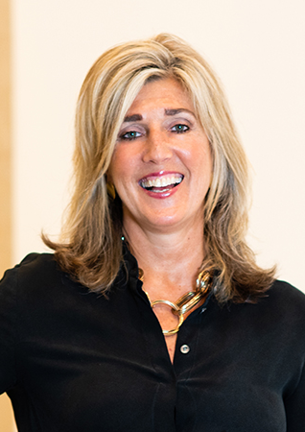
Michelle Buchanan, CFRE
Two words come to mind to describe Michelle’s counseling style – determination and results! Well actually, three words – the third is fun! While taking the work of fundraising seriously, Michelle doesn’t make the work of planning, campaigning and mentoring anything but an enjoyable experience. When in a tough spot, Michelle will settle for nothing short of success and the celebration that follows achieving a goal. Her goal is to make others better – to strengthen the skills and results of those with whom she works.
Building strong, trusted relationships was one of the secrets to Michelle’s success as a development professional and major gift officer. Michelle began her fundraising career at the Wesley Community Center, eventually serving at the University of Houston’s main campus. Before joining Dini Spheris, Michelle was a leader among the major gift solicitors at The University of Texas M. D. Anderson Cancer Center. There, Michelle managed an annual portfolio of over 150 individuals – many of whom she would come to regard as personal friends.
At Dini Spheris, Michelle has served as team leader on numerous projects. Those projects include building a centralized philanthropy program for St. Louis’ Mercy Health system, which spans four states and 32 hospitals, as well as working with Medical Center Hospital in Odessa, Texas, to create the first-ever major gift foundation. A graduate of Texas Tech University, Michelle is often heard speaking at major professional conferences in nonprofit, educational and healthcare philanthropy.
Notes:
Full bio or bullets??

Slide 3
"These days everyone has the same data regarding the present and the same ignorance regarding the future."
-Howard Marks

Slide 4
Today’s Discussion
Current Environment
Realignment to adjust to the current situation – staying relevant
Positioning for success in fundraising
  Philanthropic messaging
  Review of current fundraising plans and strategies
  Leadership and Board

Slide 5
Current Environment
Global Pandemic: One of the greatest pandemics since the Spanish Flu 102 years ago.
Failing economy: The greatest economic contraction since the Great Depression, which ended 80 years ago.
Oil Market Crash: The greatest oil-price decline in the OPEC era.
Financial Intervention: The largest central bank/government intervention of all time.

Slide 6
The Reality of Nonprofits Today
Challenges around program delivery and fundraising, prompting new ways of thinking about each.
Contact with donors is becoming even more personal and meaningful.
Communications, annual fundraising and major gifts quickly rose as priority focus strategies.
Planned giving, capital and endowment fundraising are lower priority.
Increased dependence on and use of technology.
Board members showing mixed engagement and confidence regarding fundraising.

Slide 7
Start the Process of Realignment: Budgets, Programming and Fundraising
Define not reinvent your organization’s cohesive response to change – your philosophy or strategy for moving forward with many unknowns.
Remain mission focused
Reset the budget : expense and revenue – through at least June 2021
Right size fundraising expectations: make informed adjustments; include thoughts of the Top 25 Donors
Consider collaboration opportunities
Review and confirm endowment and spending policies
Notes:
In ordinary hard times, the traditional moves (which many of us have already done now) are reducing fixed costs, scope and variety. But with this level of impact and change
Organizations will need to look beyond doing business as usual – we may need to rethink our delivery methods, our metrics, how we manage, how we work with our clients/those we serve and how we communicate.
Best analogy is a car driving down the road and hits a giant pot-hole..after this there is no way to continue driving straight, it might pull to one side, it might be bumpy…but it has to be re-aligned to regain a stable drive – and not fixing it now will definitely cause long-term damage to your tires…and your organization. Just carrying on as if you didn’t hit the pot hole will not work.

Slide 8
Positioning for Success in Fundraising

Slide 9
Philanthropic Messaging
Vision
Case for Support
Clarity
Impact and Inspiration
Opportunity or Challenge
Solution
Notes:
We used 15,000 gloves yesterday – put in others – we’re going to talk through the commonalities. Pull in survey specific
Donors don’t give to organizational needs, they give to community impact
Tells the story of the organization and explains funding initiatives
Features and benefits
Focus on impact
Explain how the organization meets the needs
Annual exercise and part of ongoing board training
Teaches the board, volunteers and staff the story
“Three-minute speech”
Focus on impact
Philanthropic motivations
What are the needs or opportunities?
What is the proposed solution?
Why is the organization qualified to address this issue?
How will the needs/opportunities be met?
How will the program/project impact those served?
What will it cost? How will it be evaluated?
What is in it for the community and donor?
The economy is the driving factor in charitable giving
Giving is more about values and relationships than money
Even when giving is down, donors will focus on those organizations with whom they are most connected
Others here
INSERT GRAPHIC or PHOTO here

Slide 10
Communication and Messaging
Crisis giving decisions are often rooted in emotion.
Crisis giving starts with a desire to STABILIZE:
  Wide-reaching local issues such as the economy and healthcare
  Access to basic needs – food, shelter, safety
Followed by a desire to RESTORE & INNOVATE:
  Continuity of pre-crisis norms
  Preventing future crises
The timeline is still evolving.

Slide 11
Communication and Messaging
People want to hear from you: generally more trust for nonprofits than other news sources.
Impact. Impact. Impact!
Offer help, not just about asking.
Ask for in-kind, as appropriate.
Offer gratitude at every turn. Consider:
  Personal calls from leadership and board members
  “Thank-yous” for long-time support
  Highlight generosity

Slide 12
Fundraising Plans
Audience | Funding Area
Individuals Foundations Corporations | Program(s) Capital Endowment
Fundraising Method | Funding Vehicles
Peer-to-Peer Events Direct Mail Social Media/Web | Cash Credit Card Donor Advised Funds Planned Gifts
Donor Cycle
Identification Discovery Cultivation Solicitation Stewardship
Notes:
If it wasn't already a lot to think through…
Mostly focusing on making sure you addressing the areas with the most need and potential for ROI
Provide some s
Once you have your philosophy for change established and priorities defined, it will be helpful to review current development plans. This will guide you as you map out the short-term actions and long-term strategy for success for philanthropy.
specific tangible examples in each section
Annual Fund
Maintaining consistency;
Communicating immediate needs;
Opportunity to transform amidst crisis.
Others ?
Events
Reschedule, Virtual or cancel
Relevant messaging
Goals
Major Gifts
Re-evaluate your annual development results and how you are deploying resources
Sources of support - any changes, heavy reliance on particular set of donors?
What has been raised this year?
How were those dollars spent?
Staff deployment + analysis of donors = right focus?
If giving has slowed, it may be time to cut back
Why we should pay attention to Donor Advised Funds
From Fidelity, second largest grant maker after Gates Foundation:
DAF donors are strategic and committed
Median age 55
Giving motivated by financial benefits and strategic planning reasons
Average account size is $19,000 making 10 grants
Over 10 years, 88% is disbursed out of $100 contribution
86% increase in new DAFs due to tax reform
Fidelity’s metrics about DAF
Fidelity advice - How do fundraisers get in front of companies holding DAFs? (1) Most DAFs bear family name and provide address so NPOs can research and (2) DAF holders gives NPOs means to connect with donors
Wealth inequality! Worst in U.S. history with top 0.1% owning 20% of all U.S. household wealth – will this lopsided society witness weaponized philanthropy?
Donor advised funds! Runaway growth + no legal requirement to distribute funds – are more donors warehousing their charitable dollars instead of putting them to work?
Mega-sized gifts! Nonprofits are losing small donors and becoming overly reliant on big donors – are NPOs facing self-serving philanthropy that will lead to mission distortion?

Slide 13
Annual Fundraising Opportunities
Use technology: Social Media, Online Messaging, Zoom
Don’t forget about regular direct mail.
Foundation and corporate opportunities for COVID-19 relief funds.
Pay attention to new donors making gifts and develop the right strategy to engage long-term.
Rethink and evaluate special events moving forward. However, don’t hesitate to ask for virtual sponsorships and be creative with marketing.

Slide 14
Major Gifts Opportunities
Donor Advised Funds (Fidelity is the second largest grant maker after Gates Foundation):
  DAF donors are strategic and committed
  Median age 55
  Giving motivated by financial benefits and strategic planning reasons
  Average account size is $19,000 making 10 grants
  86% increase in new DAFs due to tax reform

Slide 15
Major Gifts Opportunities
Pay attention and market tax advantages:
  In 2020, individual taxpayers who do not itemize will be eligible to claim up to $300 in charitable contributions as a deduction.
  Cash contribution limits have been raised for gifts to public charities (though not to donor advised funds or supporting organizations):
    Individual taxpayers are now subject to a limit of 100% of AGI (up from 60%).
    Corporations are now subject to a limit of 25% of pretax income (up from 10%).
    Food inventory contributions are now subject to a limit of 25% of pretax income (up from 15%).
    Excess contributions may be carried over.

Slide 16

Organizational Leadership
Early decisions make the greatest impact
Make hard decisions based on sound strategy and don’t look back
Build confidence by realistic
optimism
Instill trust by communicating the
good and the bad along the way
Notes:
This is primarily for CEOs and Executive Directors, but can also be for Board Chairs.
For all staff, especially Development directors – don’t stop, find a solution
The world will right itself and those that adjust to the downed tree on the trail and work through solutions to get over and around it will get ahead in the long run. Those who stop, as proven in the 2008 recession, will have a hard time gaining momentum again and will be way behind their competitors.

Slide 17
Board Leadership
Lead by example – communicate and engage, be proactive – tell your story and impact.
Every person has a different perspective and situation – don’t determine where someone stands until you have talked with them.
Take the time to know your top donors and how this crisis is impacting them as well.
Be a part of the team that builds confidence.

Slide 18
A Word About Campaigning
If essential, don’t stop.
Stay focused and use the time to strengthen case and revisit the budget.
Celebrate: Gifts are still being made.
Consider phased goals and opportunities based on alignment with COVID-19 relief.

Slide 19
“We believe there are moments in life that should be defined by our vision, values, hopes and dreams, not by a virus.”
Gary Friedman
Chairman & CEO
Restoration Hardware

Slide 20
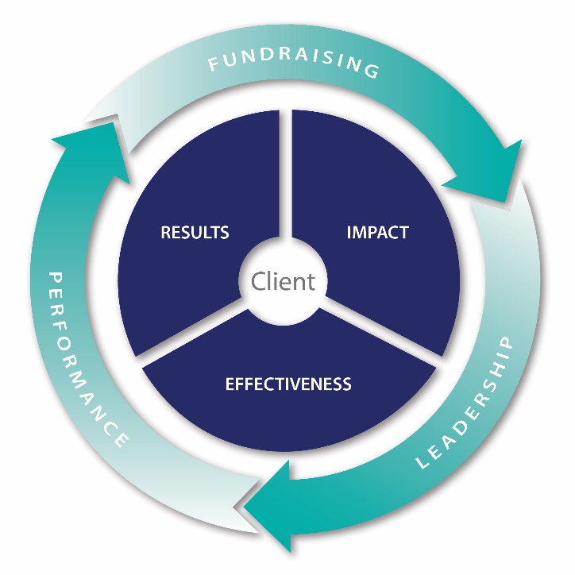
Dini Spheris
Deep, nationwide knowledge of fundraising, leadership and performance across philanthropic sectors
Forward-thinking, trusted partners in solutions and success
Client-centered, holistic approach to service delivery
Willingness to think outside the box of traditional fundraising
Customized solutions for your institution today and where you desire to be
As employee-owners, we treat each client’s project and challenge as our own

Slide 21
Contact Information
Dini Spheris
2727 Allen Parkway, Suite 1650
Houston, TX 77019
Michelle Buchanan, CFRE
Principal
mbuchanan@dinispheris.com
713.962.5010

